Slide 1
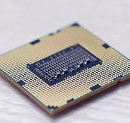
Cache MEMORY
Presented By :
Muhammad Awais Saleem
Mubeen Anwar
Sania Sarwar

Slide 2
Contents
Cache Address
Cache Mapping Function
Cache Write Policy
Elements of Cache and Design and Typical Cache Organization

Slide 3
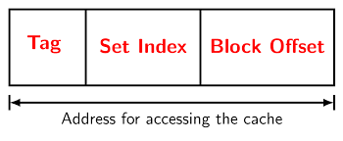
Cache address
Definition :
"Cache address refers to the location of a particular piece of data or instruction in the cache memory."
When the processor needs to access data or instructions, it first checks the cache to see if the data is already there. To do this, the processor uses the memory address of the data as a key to search the cache.

Slide 4
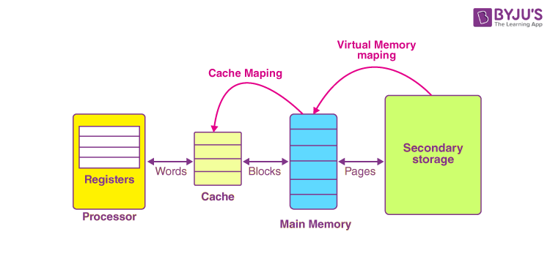
Cache Mapping function
Definition :
"Cache mapping function is a technique used by the processor to determine where to store data in the cache memory."
There are common three types of cache mapping functions:
Direct Mapping
Set-Associative Mapping
Fully Associative Mapping

Slide 5
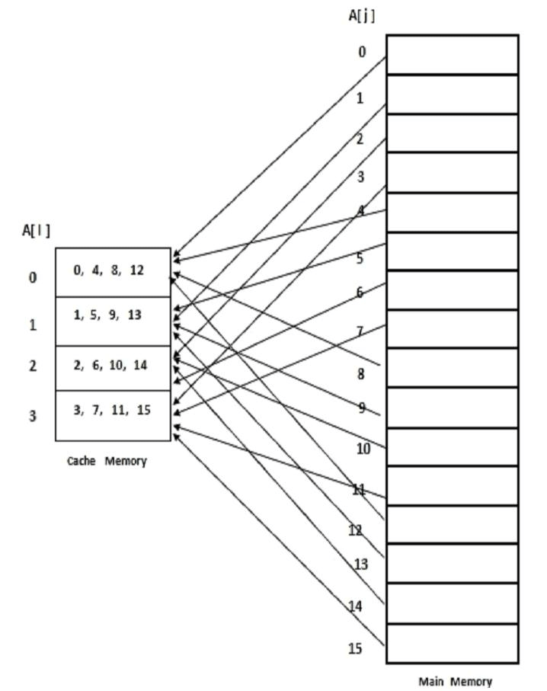
Types
Direct Mapping :
"In direct mapping, each block of main memory is mapped to exactly one block in the cache."
This means that if two blocks of main memory have the same index, they will be mapped to the same block in the cache.
This can cause conflicts when multiple blocks of main memory are mapped to the same block in the cache.

Slide 6
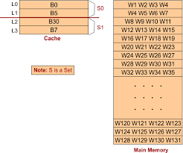
Types
Set-Associative Mapping :
"In set-associative mapping, each block of main memory can be mapped to a set of blocks in the cache. "
This reduces the number of conflicts compared to direct mapping, but it requires more complex hardware to implement.

Slide 7
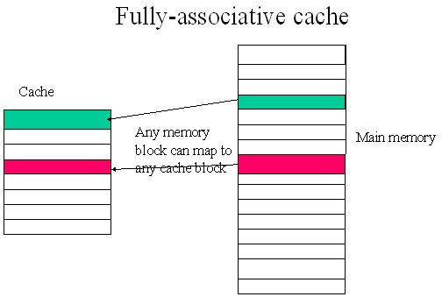
Types
Fully Associative Mapping :
"In fully associative mapping, each block of main memory can be mapped to any block in the cache. "
This eliminates conflicts completely, but it requires even more complex hardware to implement.

Slide 8
Cache write policy
Cache write policy refers to the way the processor handles writes to the cache. There are two common cache write policies:
Write-through :
In write-through, every write to the cache is also written to main memory. This ensures that the data in the cache is always up-to-date, but it can slow down write operations.
Write-back:
In write-back, writes to the cache are not immediately written to main memory. Instead, they are only written to main memory when the cache block is evicted from the cache. This can improve write performance, but it can also lead to data inconsistencies if the cache is not properly managed.

Slide 9
Elements of cache design and typical cache design
The three main elements of cache design are size, associativity, and block size.
Size: The size of the cache is determined by the number of cache blocks it can hold. Larger caches can improve performance by storing more data and instructions in the cache, but they also require more hardware resources.
Associativity: The associativity of the cache determines how many blocks of main memory can be mapped to a single block in the cache. Higher associativity reduces conflicts, but it also requires more hardware resources.
Block size: The block size of the cache determines the size of each block in the cache. Larger block sizes can improve performance by reducing the number of cache misses, but they can also increase the number of conflicts.

Slide 10
THANK YOU :)

